Slide 1




HOME
ABOUT
MORE
AUGMENTED REALITY
AR Waste Sorter & Recycle Guide
RX KING

Slide 2


HOME
ABOUT
MORE
OUR TEAM
Izzat Aji Androfaza Moch. Irham Maulana Daffa Diandra Rizky A.
5025221245 5025221251 5025221261
Joseph Marcell Gultom Winston Juliand Sitranata
5025221279 5025221285

Slide 3
HOME
ABOUT
MORE
INTRODUCTION
What is Augmented Reality:
“A technology that overlays digital elements — such as 3D models, text, or animations — onto the real-world environment, often through a smartphone, tablet, or AR headset.”
In short:
Augmented = Real world + Virtual layer (combined together)

Slide 4
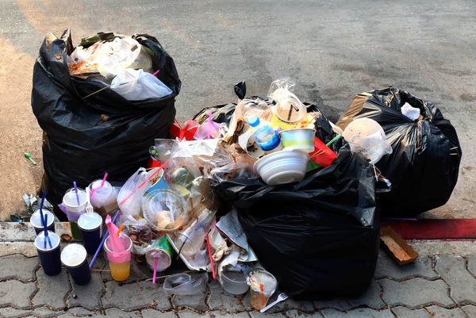

BACKGROUND & MOTIVATION
Indonesia produces millions of tons of waste every year.
An interactive, educational, and engaging solution is needed to increase waste-sorting awareness.
There is a lack of education on how to sort and recycle waste properly. Many people are still confused: "Does this bottle go into the plastic or glass bin?"

Slide 5

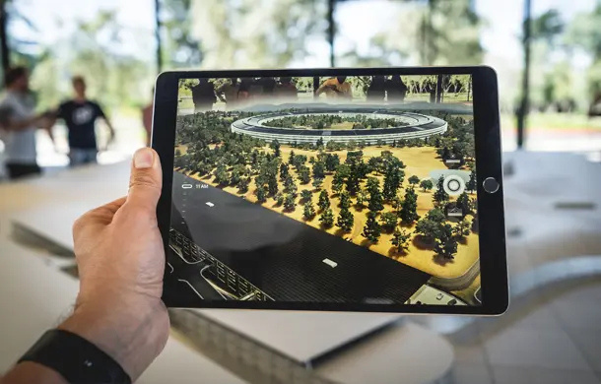
PROBLEM STATEMENT
  People find it difficult to quickly identify different types of waste.
  There is a lack of information about proper disposal locations.
  A lack of motivation exists due to the absence of a reward system.
  Objective:
To develop an Augmented Reality application that recognizes different types of waste bins and allows users to interactively learn proper waste sorting by placing digital waste objects into the correct bins through gamified experiences.

Slide 6
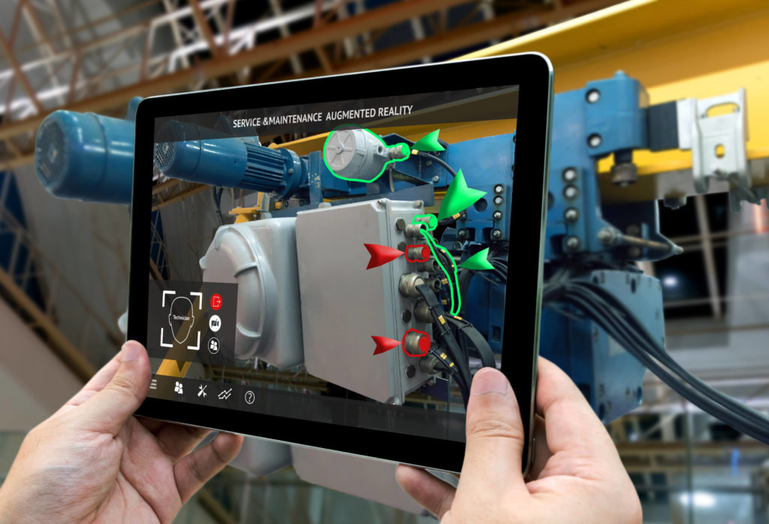

APP MAIN CONCEPT
Concept
  Use the AR camera to detect the type of bin (organic, non-organic, etc.).
  users choose a digital waste item and throw it into the detected bin.
  If the waste matches the bin type → correct! (+points).
  If not → wrong output with a short tip or warning.
The AR Visual Overlay displays:
  The bin label and color.
  The digital waste object.
  DIY recycling ideas (e.g., plastic bottle → plant pot).

Slide 7
MAIN FEATURES
Feature | Description
🗑 Bin Recognition | Detects waste type via camera and displays AR labels
🧩 Digital Waste Interaction | User can drag or throw digital waste into the detected bin
🎮 Gamification | Earn points for correct sorting, compete in a leaderboard
📊 User Stats | Tracks progress, scores, and learning history
💡 Recycling Tips | Shows ideas for DIY recycling

Slide 8
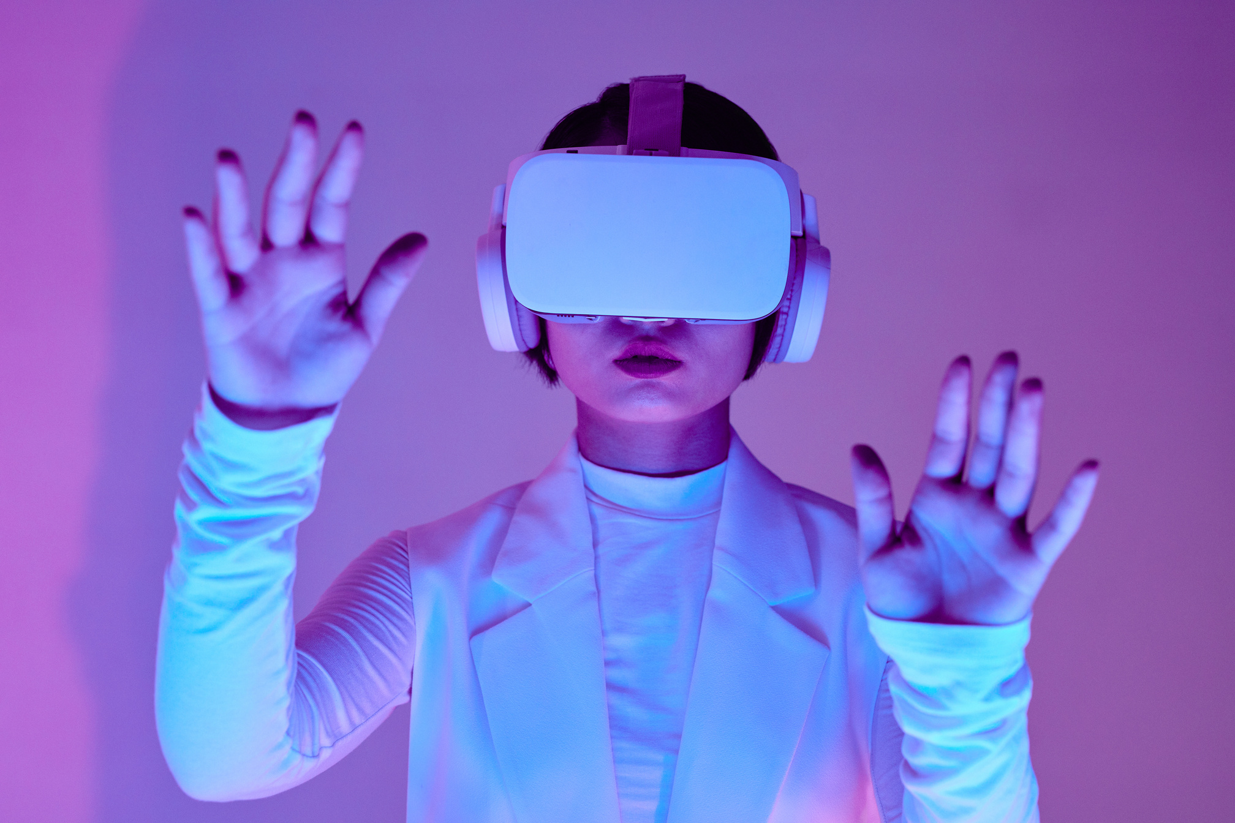
WORKFLOW
Open the AR camera.
The app scans the real environment.
Detect the bin.
The system recognizes the bin type (organic, plastic, paper, etc.) and shows its label.
Select digital waste.
The user picks a virtual waste item (like a bottle or banana peel).
Throw it into the bin.
The user drags or throws the digital waste into the detected bin.
Check result.
  ✅ If correct → gain points and animations appear.
  ❌ If wrong → feedback or recycling tips are shown.
Save progress.
Points and achievements are recorded in the leaderboard.

Slide 9
REFERENCES
www dotcom
RX KING TEAM

Slide 10
THANK
YOU
RX KING TEAM

